Slide 1
Current
TOP 100
NBA Player
Visualizations
As of Dec 2023
Notes:
This project aims to conduct a detailed analysis of the Current Top 100 NBA players’ performances, focusing specifically on the correlation between player demographics (age and hometown) and the nine standard statistical categories for the 2023-2024 season (using pre-season projected and current performance measures). This analysis is not only pertinent to sports enthusiasts and analysts but also holds significant value in the domains of both sports management and betting industries. Understanding the impact of demographics, namely age, on performance can aid in player development, team composition internally, betting strategies for industry outsiders and plenty of other real life applicable relevant uses.

Slide 2
Agenda
01
Introduction
02
Data Description
03
Data Preparation
04
Visualizations
05
Conclusion

Slide 3
Introduction
As NBA players age, they change their game and perfect their craft.
Modern Medicine and Health Practices have evolved and continue to immensely improve over the past couple decades.
Are we accurately accounting for off-court factors in our player evaluations? Are we over-accounting the modern effects of age?

Slide 4
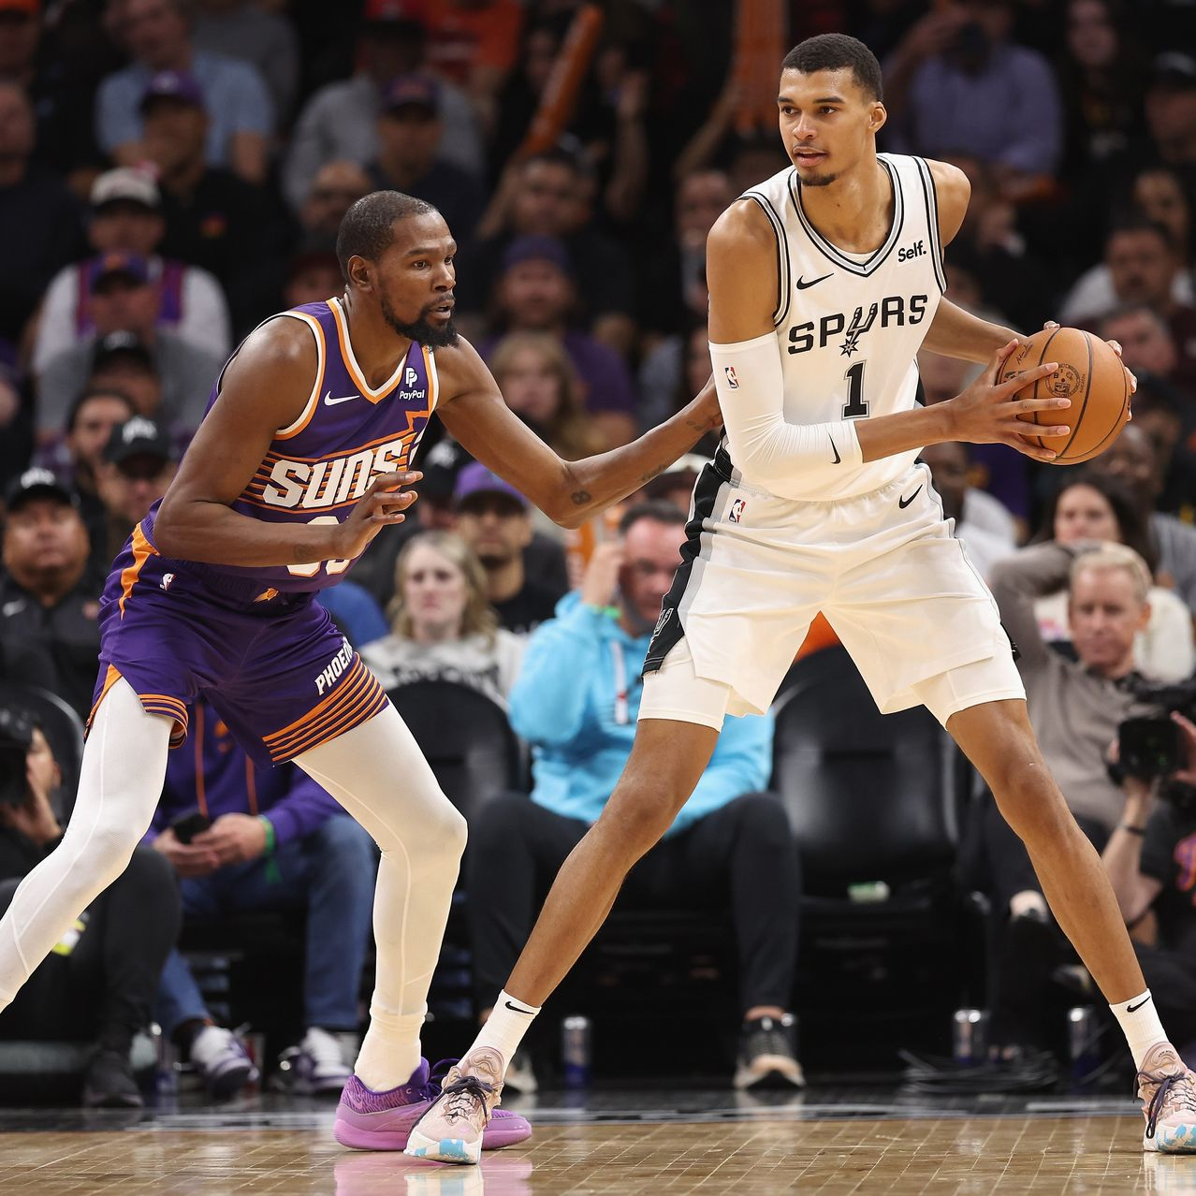

Hypothesis
Age correlates with certain improvements or declines in specific statistical performance categories. For instance, older players might show a pattern of underperforming in some projected performance categories for the season.
However, the negative impact of old age is overestimated in projections as modern medicine and longevity-focused practices have improved dramatically in recent years.

Slide 5
Data Definitions
FG
3PT
Field Goal Percentage
3-Point Goals
FT
AST
Free Throw Percentage
Assist
BLK & STL
TO
Blocks and Steals
Turnovers
Notes:
Field Goal Percentage is probably the most important indicator of efficiency, as it shows how many times players are scoring points out of a hundred (excluding free throws). 3-Point Goals are points scored from a farther distance, which are worth 3 instead of 2. Free throw percentage is the amount of times players score free throws out of a hundred. Assists are the passes to the players who end up scoring, blocks and steals are self-explanatory, usually related to defensive-role players, and turnovers are the times where players lose the ball to the other team.

Slide 6
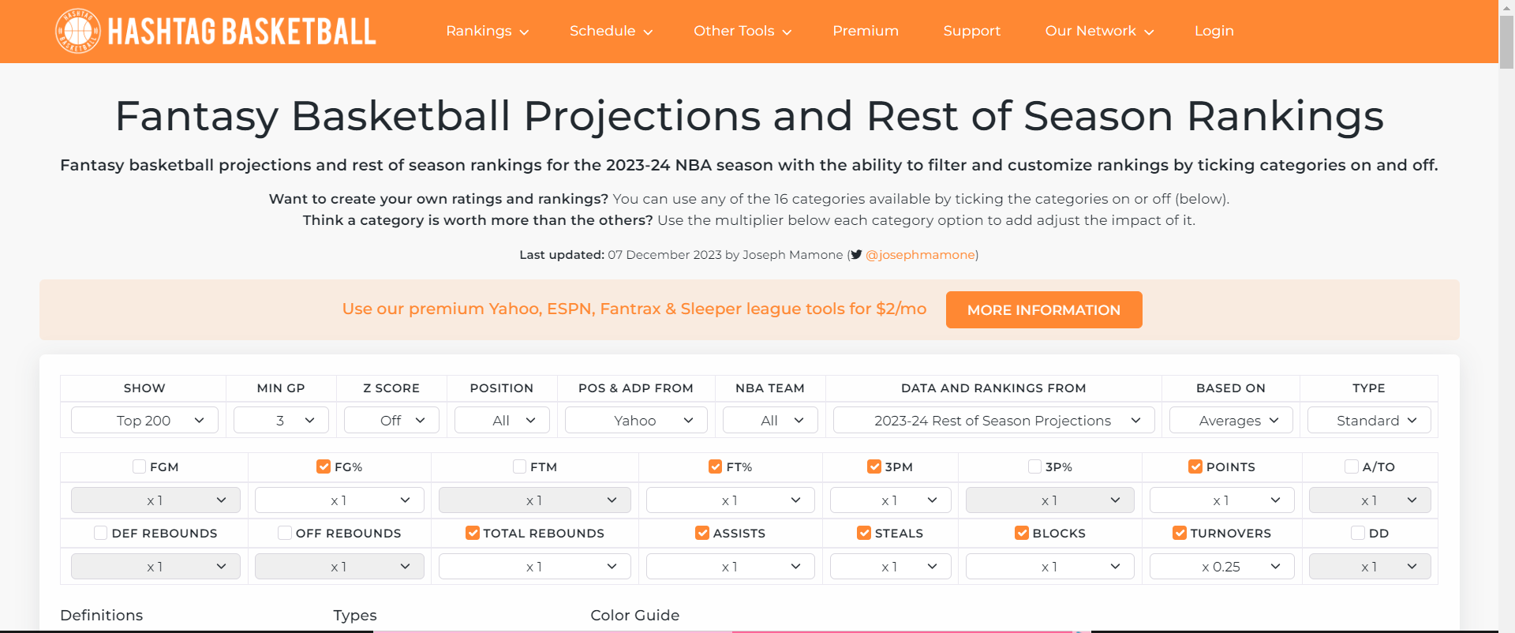
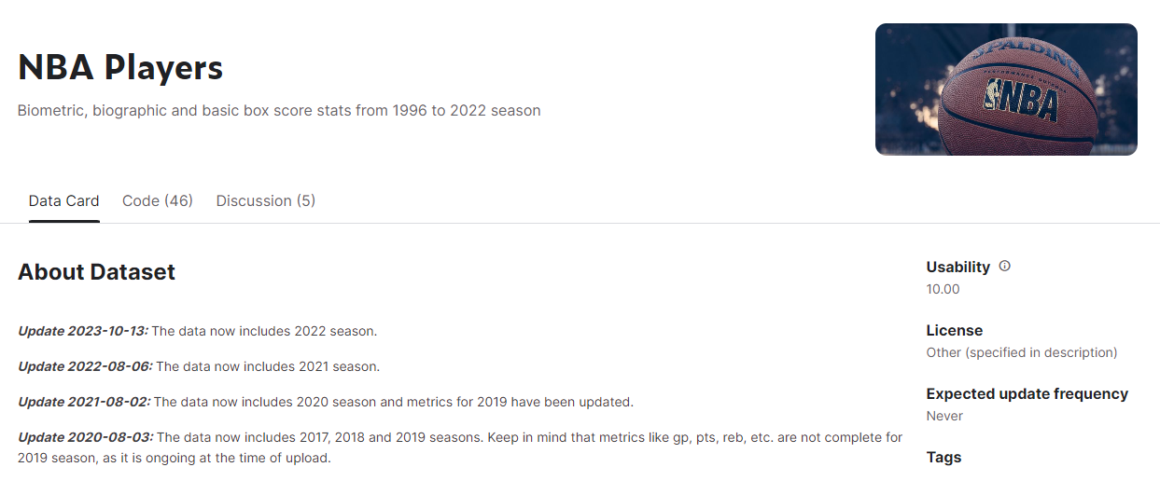
Data Preparation
Three files were joined:
Top_100_players_with_predicted_stats.csv
(Source: Hashtag Basketball Projections)
Top_100_players_with_actual_stats.csv
NBA_Player_demographic_data.csv (Source: Kaggle)
Notes:
Top 100 players with their predicted stats before this season begin
(Source: https://hashtagbasketball.com/fantasy-basketball-projections)
Top 100 players with their actual stats until late November
(Source: https://hashtagbasketball.com/fantasy-basketball-projections). Contained a lot of blank cells. Filled player’s age, birthplace, predicted and actual points.
NBA Player’s demographic dataset (Source: kaggle )

Slide 7
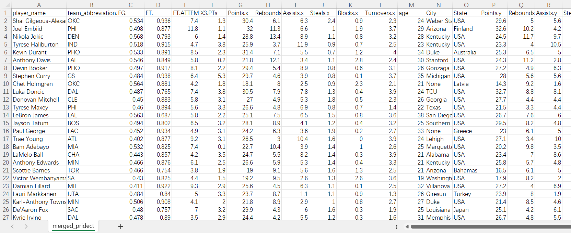

Data Preparation
Notes:
The field “player_name” joined these three datasets. The main demographic variables used are players’ name, age, and hometown. Using the nine default statistical categories (9-cat), then used the predicted stats, and compared those to the actual stats of this season (2023-2024). Variables with suffix ‘x’ are the actual points players scored. Variables with suffix ‘y’ are the predicted points that the player was predicted to get before the season began. A challenge faced were some top 100 players are new to the NBA field which caused n/a to exist in the joined file, so I had to manually fill those demographics as a data set was not available.

Slide 8
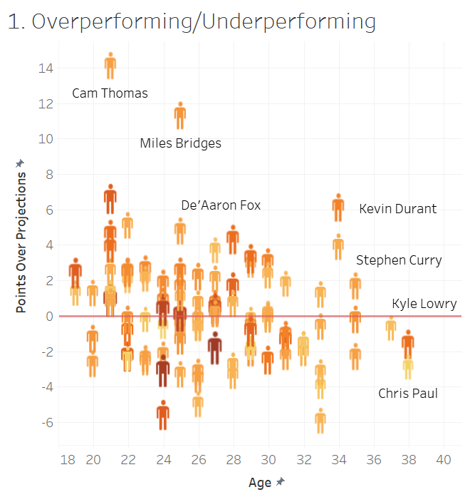
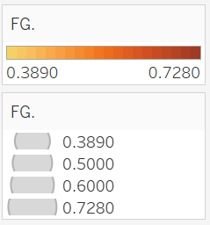
Performance
Points Over Projections:
Actual Points - Projected Points
for this season
We expect young players to perform better earlier.
Age is a constant factor in evaluating players over 30
At what age are players more likely to overperform?
Notes:
There are common tropes when people talk about sports. We see more and more that we as viewers are impatient and expect younger players to emerge as superstars earlier on in their career and they are meeting our expectations. The expectation of regression that players like Lebron experience and prove wrong has led to the question: “Are we overvaluing the effects of age in professional NBA athletes in 2023?”
Here we see a graph showing Points Over Projection vs Age meaning how much are players are overperforming/underperforming compared to what experts thought they would do this season. See that the players who are majorly overperforming their projections are indeed younger players (rookies’ breakout season). At the same time, older players have less variance, which may be in part due to them having more years of data for analysts to work with. This graph interestingly enough doesn’t show any exact trends between age and overperformance, but it is showing breakout seasons from players like Cam Thomas and De’Aaron Fox and at the same time we are seeing that some of the oldest players are underperforming.
The gradient of orange is each player’s Field Goal Percentage (measure of efficiency; how many times players are scoring points (excluding free throws) out of 100). The darker shade of orange indicating that those players are more efficient. There is a concentration of these more efficient players at the center of the visualization. Interestingly, many of the most efficient players are performing close to their predictions or under and based on age, they have intermediate experience playing in the NBA.
The design of this scatterplot with man-shaped points represents each of the NBA players. A red line was added at 0 to delineate and emphasize the baseline whether players were either over the line, thus overperforming or underperforming, marked below the line. The color gradient of Field Goal Percentage was also added to emphasize if efficiency was correlated with performance being over or under. Though there was no correlation, it did somewhat indicate an intermediate experience level of players.

Slide 9
2. Where are points from?
Notes:
For the second set of visualizations, I wanted to explore where the points this season are from - or in other words, where in the world are the top 100 NBA players from and how many points are they scoring? This is important because consistently the MVP (most valuable player) tends to be from outside of the US.

Slide 10
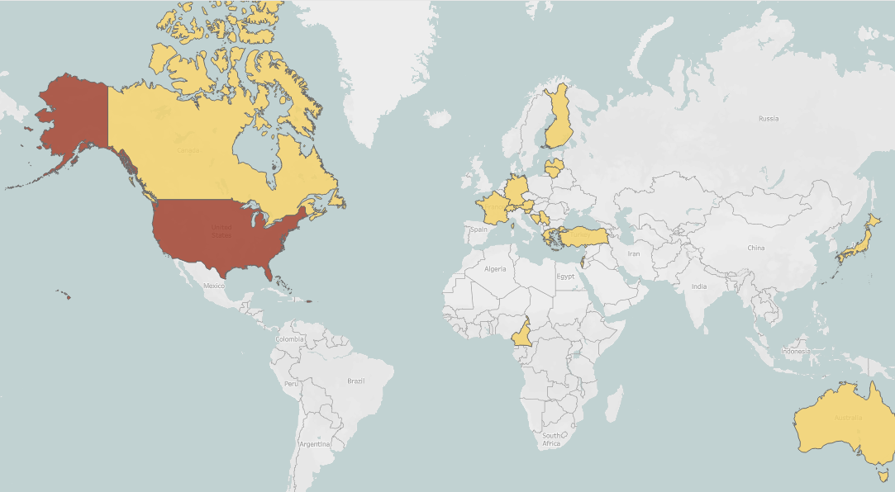
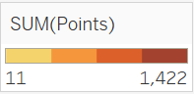
Points Per Country
Notes:
Points are the most fundamental part of NBA games since the team that scores the most points wins the game. We began exploring this through a map of the world, finding that 76/100 of the top players are from the United States. The other 24 players come from all around the world. On this view of the world map, points are divided into 4 categories/colors from 11-1,422 points.
Due to a majority of the players hailing from the US, a vast majority of points scored (1,422 points) are from US-born players.

Slide 11
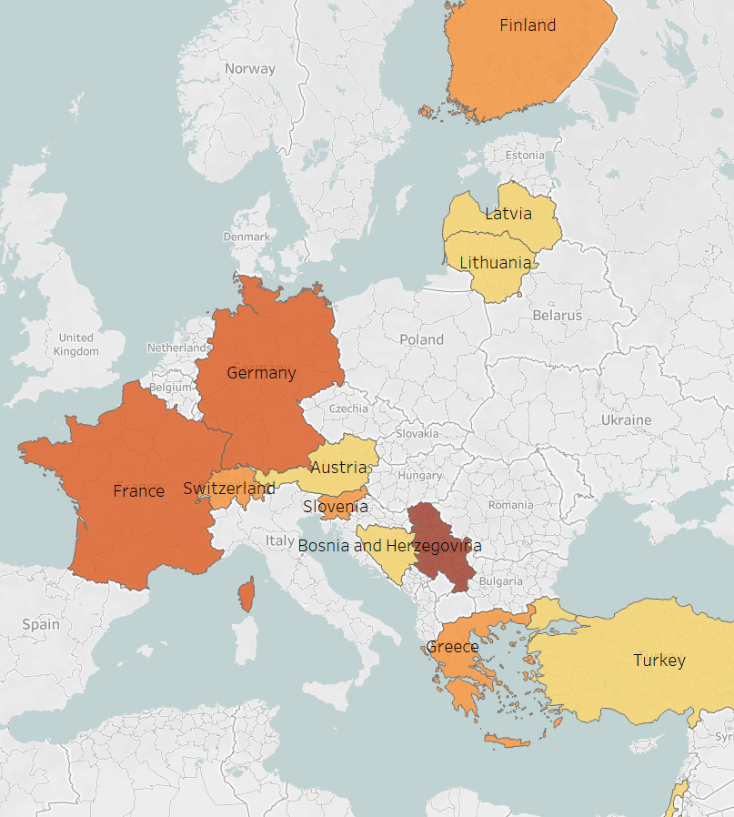
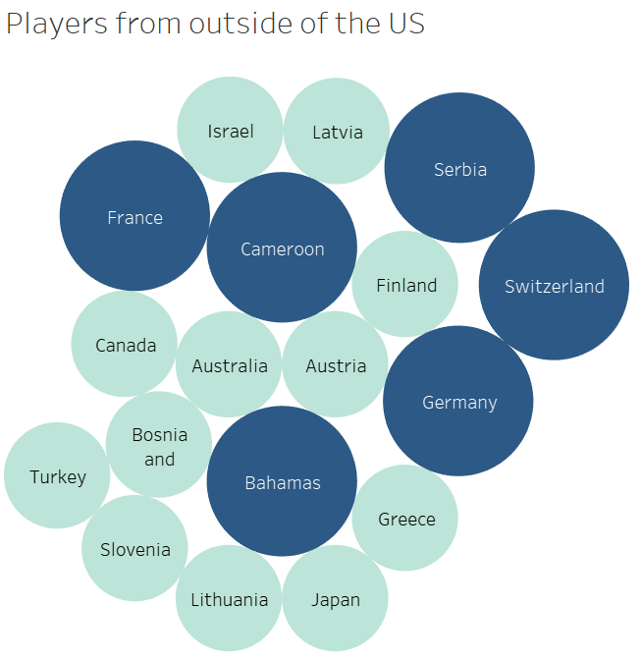
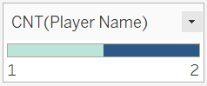
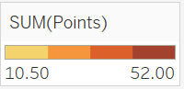
Points Outside of USA
Notes:
Going into more detail about the 26 players from outside of the US: On the left is a packed bubble graph depicting each country these players are from ranging from 1 - 2 players per country. On the right, is a zoomed in view of the world map centered around Europe, where a majority of these 26 players are from. The point color key was adjusted to a smaller scale to show more detail in how many points were scored. This key remains divided into 4 categories/colors with this scale being 10.5 - 52 points scored. There is more variation in points per countries in Europe in this view. The country with the highest amount of points is Serbia with 44.6 points and 2 players.

Slide 12
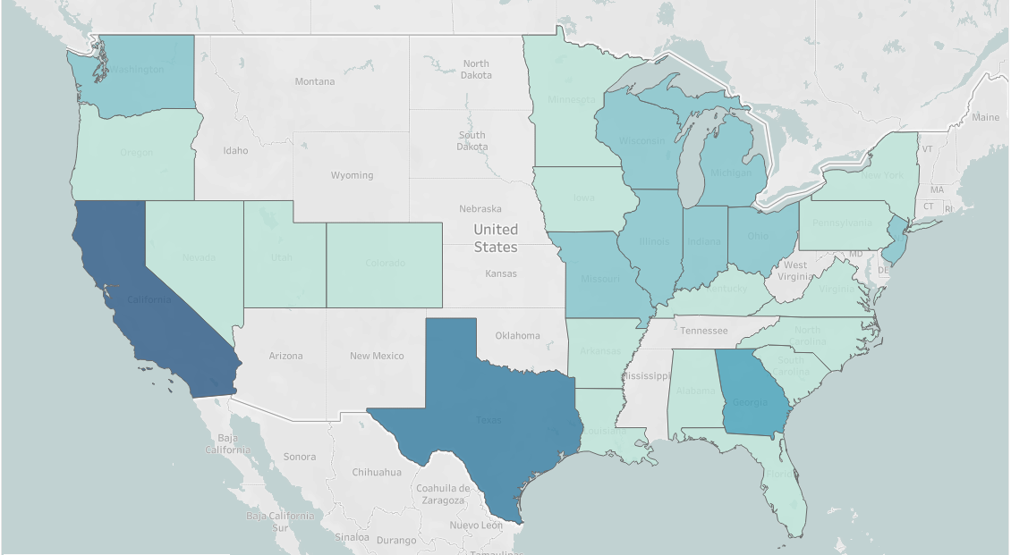
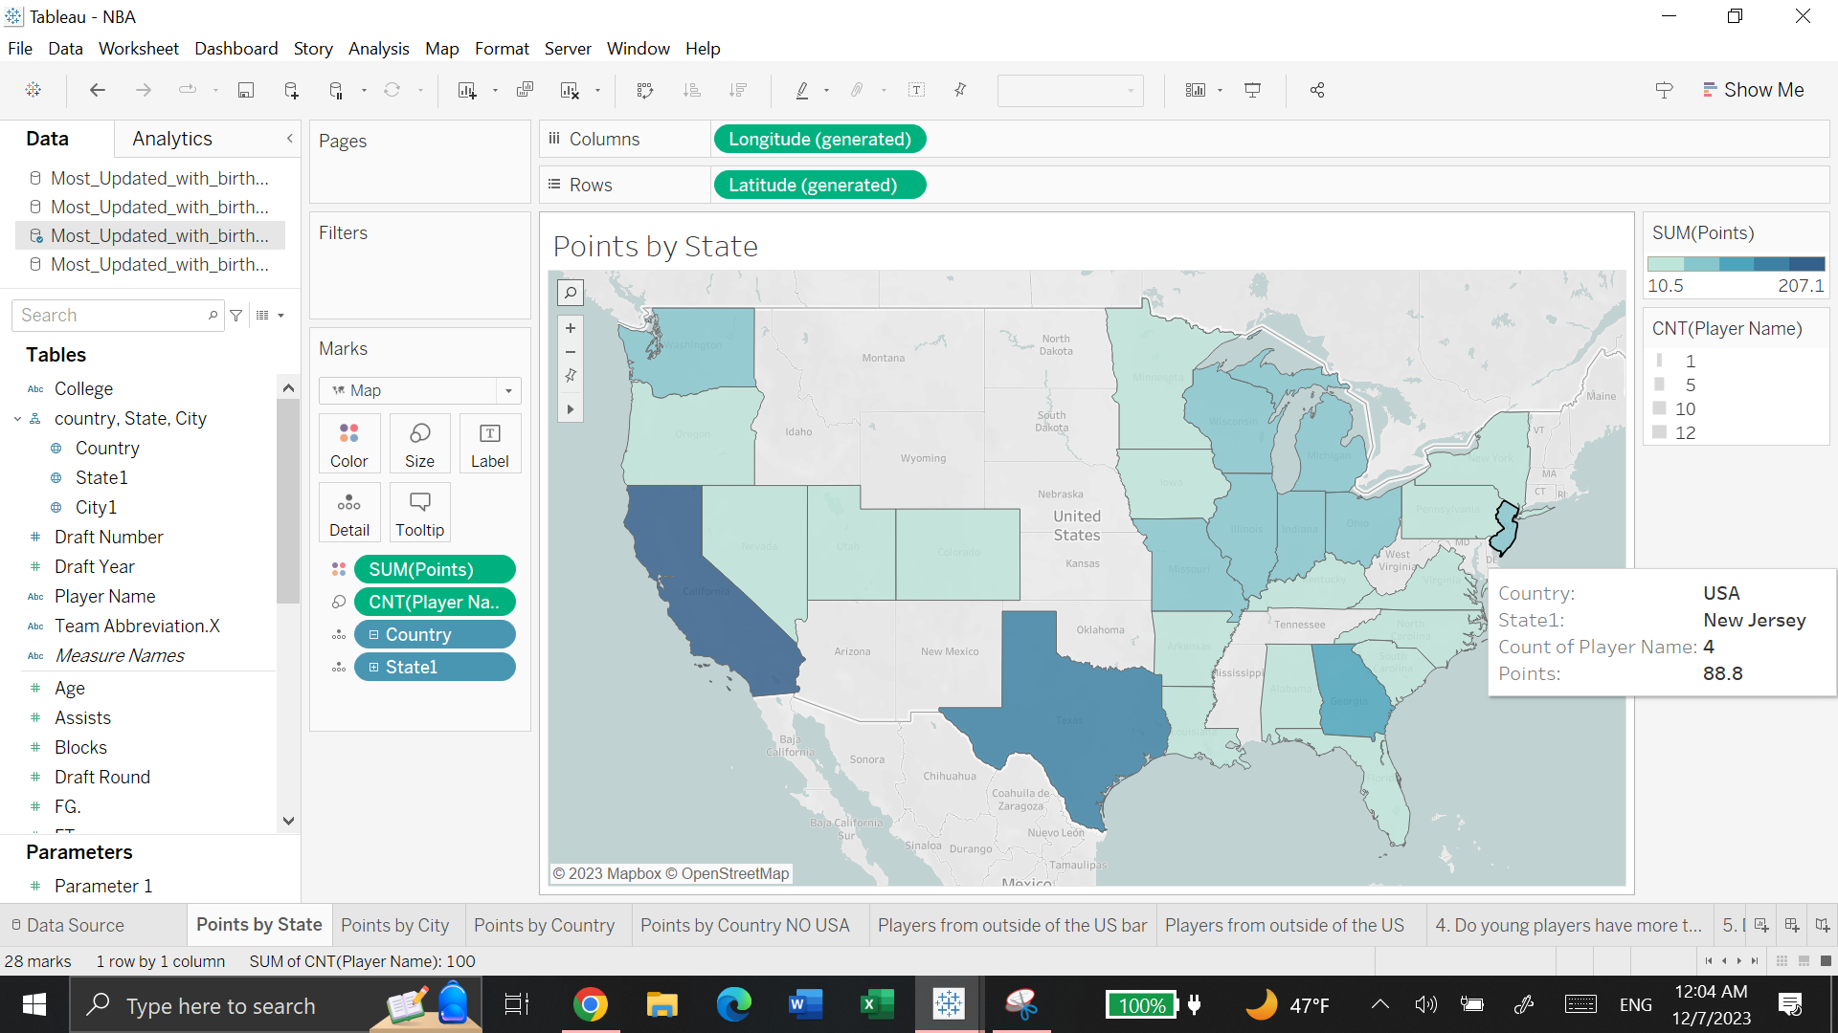
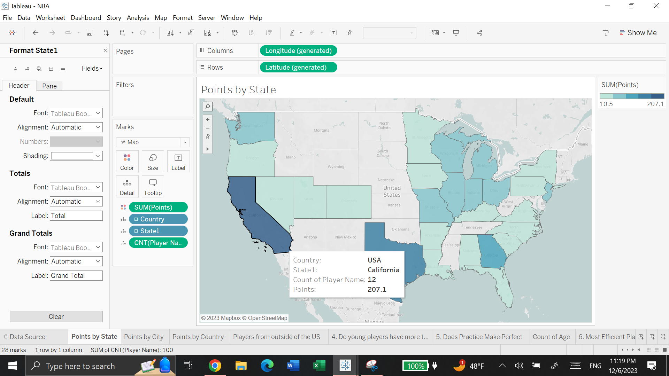
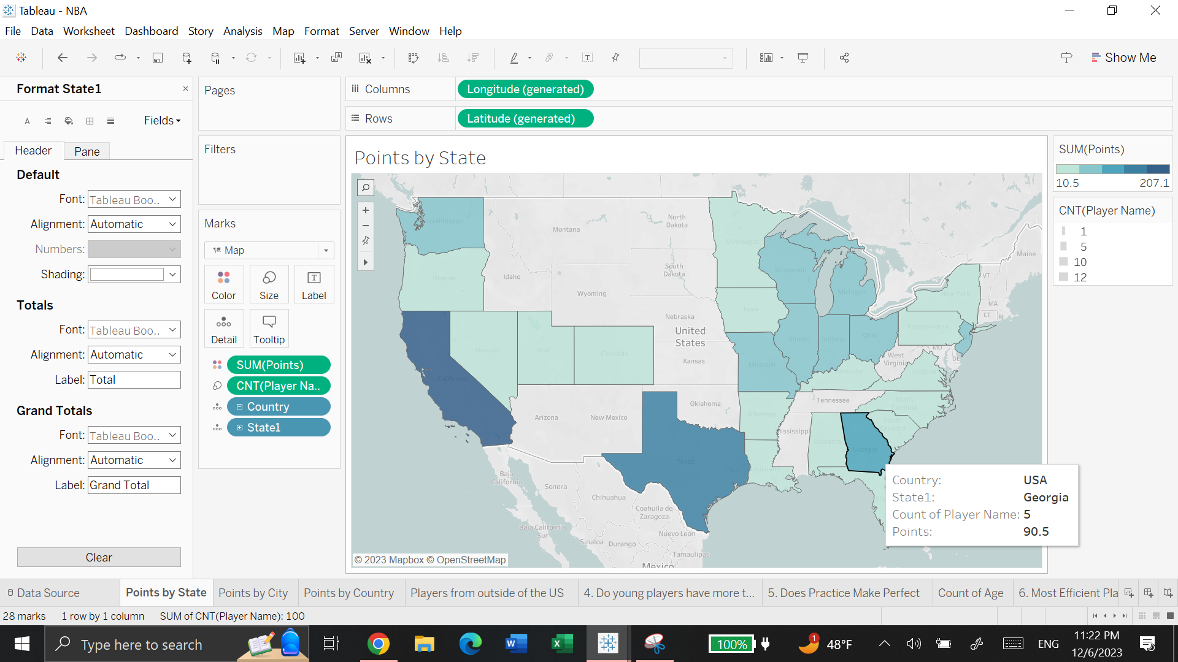
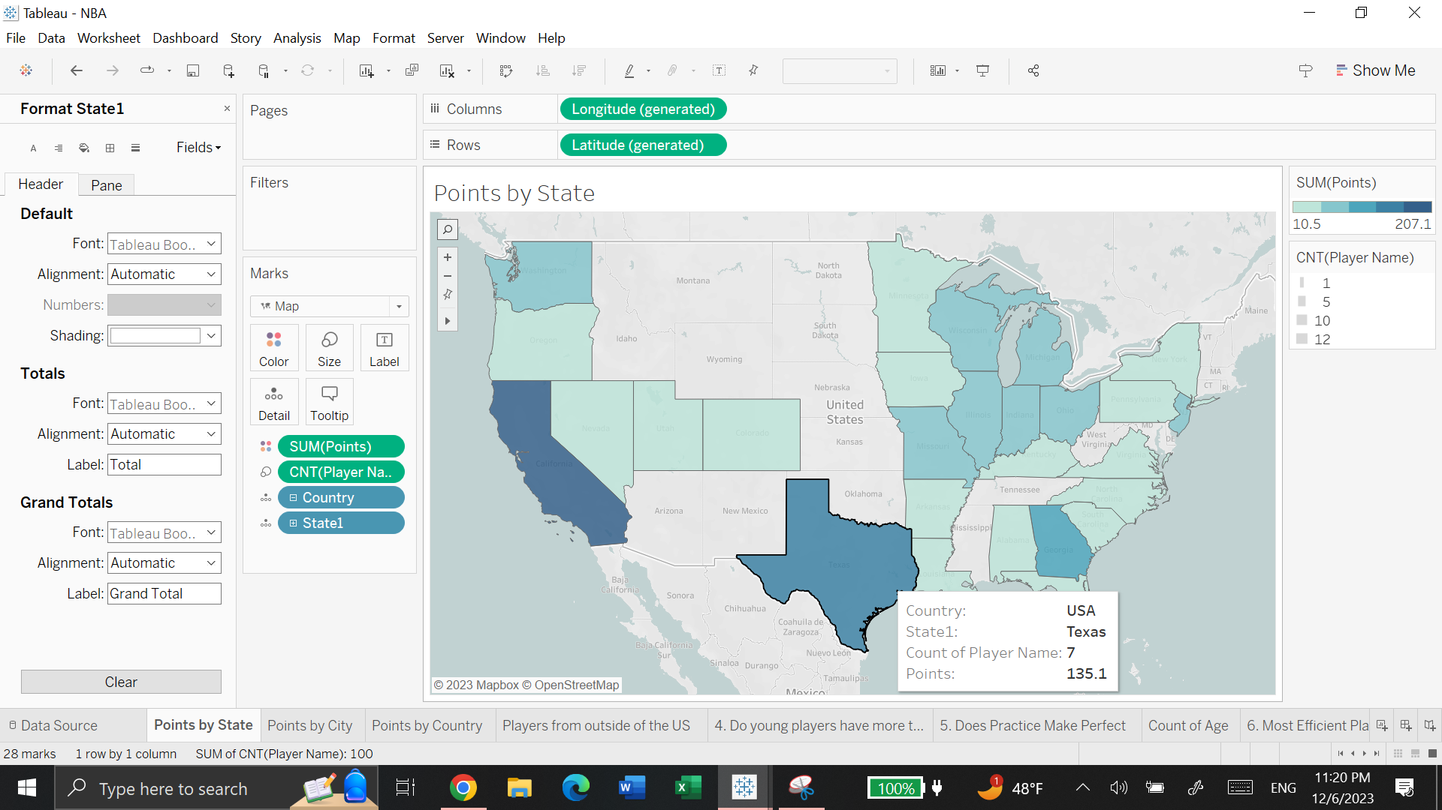
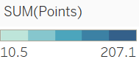
Points Per State
Notes:
(Click through animations for CA, TX, GA, NJ).
A majority of the top 100 players are from the US - 76/100 players. California has the most amount of points scored with 207.1 points and 12 players from here. This is followed by Texas with 7 players scoring 135.1 points. Finally, with the third largest amount of points is Georgia with 5 players scoring 90.5 points of this season.
The 4th lightest color indicating the range of 52.8-88.8 points scored includes 8 states: Washington, Missouri, Illinois, Wisconsin, Michigan, Indiana, Ohio, and New Jersey. With 3 players from each state, except New Jersey which has 4 players and the highest amount of points scored for its category. I chose a stepped color key instead of a gradient for these maps to make cutoffs of points scored less ambiguous.

Slide 13
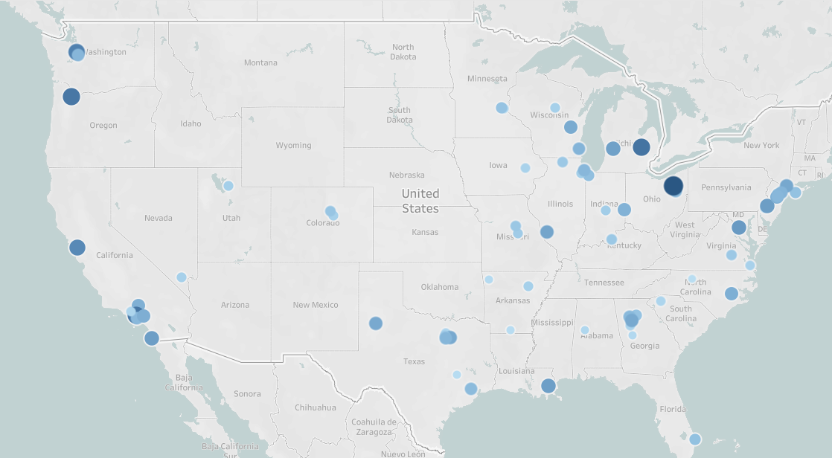
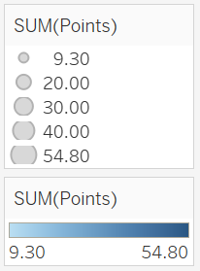
Points Per City
Notes:
Next, I explored the geographic point breakdown at its lowest level - cities. The larger the size and darker the color of the points on the map indicate more points scored. The largest and darkest spot on the map representing Akron, Ohio indicating that the best players come from this city. These 2 players are the most famous and some of the best performers in the NBA: Stephen Curry and LeBron James.
While this study has a main focus on the correlation between player performance and age, these geographic maps show pretty cool information. Location is similar to age in the sense that it is an off-court variable. A factor that impacts players that we cannot see on court.

Slide 14
3. Do Younger Players Have More to Prove?
Notes:
One of the most interesting topics in this project was understanding the statistical differences between young players and veterans.

Slide 15
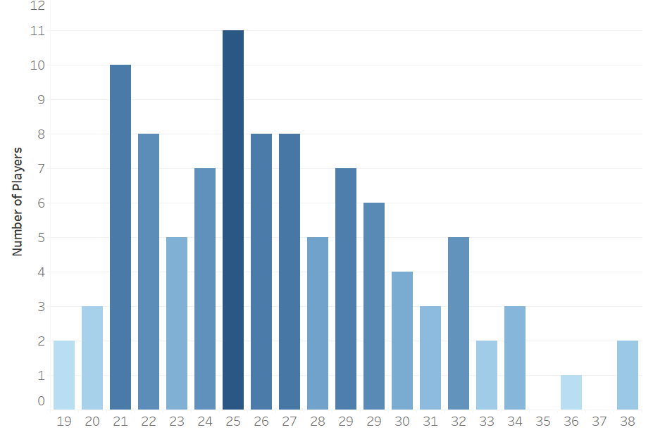
Age Distribution
Notes:
Basketball, like most professional sports, is a very physically demanding sport, where only top players remain in the league for more than 10 years. In this graph, most of the Top 100 players are 25 years old, which makes perfect sense, as 25 is defined as the year of peak athleticism. A lot of top players being only 21 or 22, opens up a couple questions we will explore through the next couple visualizations.

Slide 16
Player Contracts
Rookie Veteran
Ausar Thompson
Joel Embiid
Herbert Jones
Average
Annual Salary:
$9,061,601
Average
Annual Salary:
$13,456,968
Average
Annual Salary:
$53,320,232
4 year / $36,246,405
4 year / $53,827,872
4 year / $213,280,928
Source
Source
Source
Notes:
Why are younger players with less experience in the NBA outperforming older players? The answer might be found when we take a look at how NBA contracts work. When players first enter the league, they are limited to rookie contracts. To put this in perspective, the rookie contract used in this example is one of the highest. These players know that their opportunities to get a huge raise depend on how good they perform during their first four years. Rookies like Ausar Thompson are expecting contracts like Joel Embiid’s, rather than Herbert Jones’.

Slide 17
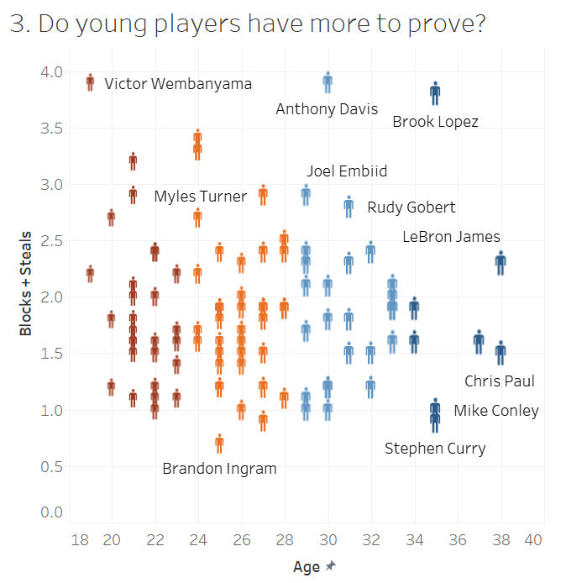
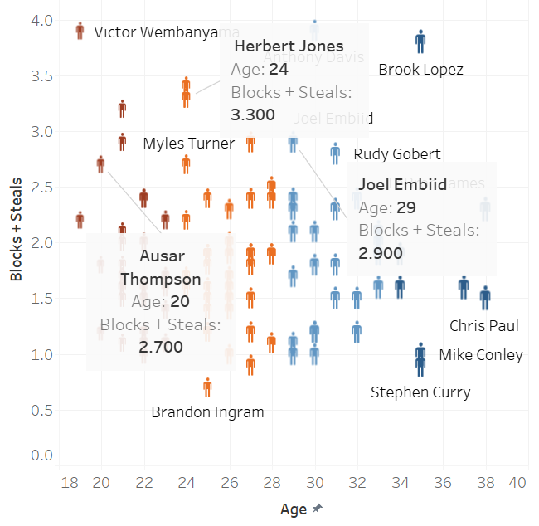
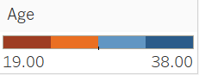
3. Do Younger Players have More to Prove?
Blocks & Steals:
“Hustle Stats”
Rookie Contracts (4 years)
The need to “earn your spot”
Peak athleticism: 25 y/o
Notes:
(Click for animation highlighting players on the previous slide)
So, for rookie players entering teams that already have superstars, how can they excel? If someone on your team is the target man for scoring, maybe they have to hustle in other aspects of the game in order to stand out. Blocks and steals are a perfect option, as these stats demonstrate physical effort. This visualization analyzed top players (by age), and how were they performing in these “Hustle Stats” (defensive statistics). You can see how young talented players like Victor Wembanyama, who also holds the biggest rookie contract ever recorded with $12M a year, is the best defensive performer. Other young players like Myles Turner are also doing great defensively this season, and you can also see older players like Anthony Davis and Brook Lopez, who are very tall, are great defensive players.
Similar to our first visualization, the design of this scatterplot with man-shaped points represents each of the NBA players. Also chose to add a diverging stepped color scale to have age be broken down into 4 bins to emphasize that defensive statistics have a pretty even spread throughout each age group. It’s noted that there were few older players 34+ years old, though despite this their defensive statistics have a general consistent spread much like the other age groups.
Younger players are generally more expected to “earn their spot” while older, more decorated veterans don’t have the same expectations on a night to night basis. While defensive stats are still representative of a players skill they are much more determined by hustle and grit. Younger players are much more incentivized to try harder on defense resulting in more defensive stats on their score sheet.

Slide 18
4. Does Practice
Make Perfect?
Notes:
Are older players less valuable? Of course not, there’s a reason they stay in the league for over a decade. So, where do they help? Where do they get better? What do they have to do in order to stay in the league?

Slide 19
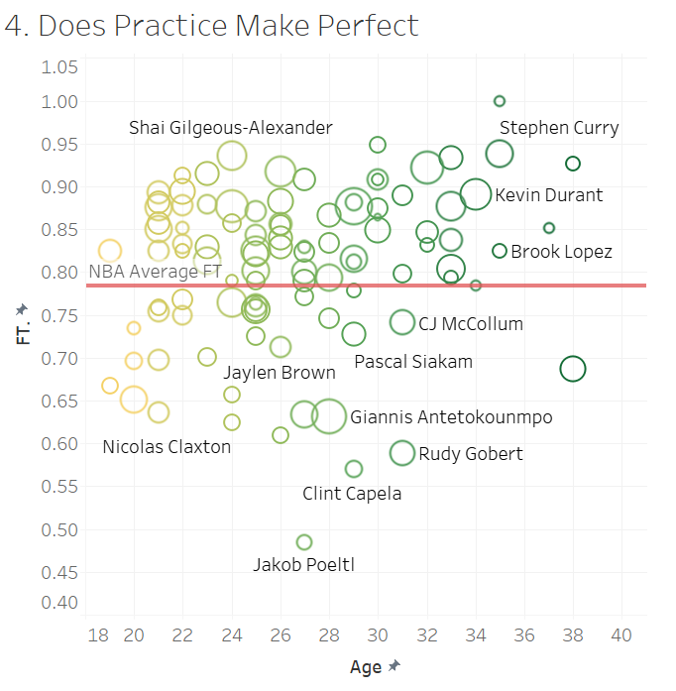
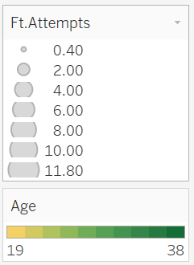
4. Does Practice
Make Perfect?
Notes:
This visualization depicts Free Throw percentage vs Age. With the size of the points indicating Free Throw Attempt Percentage. The red line is the NBA’s free throw average at .784. So, we expect that a majority of these top 100 players should be above the red line and make their free throws 78.4% of the time. We conclude from this visualization that yes, practice does make perfect because there is a slight positive trend up with age; meaning older players tend to make their free throws more often than younger players. It also explains that for older players to be able to stay in the league for long with a below average FT%, it’s because they’re performing outstandingly in a different aspect of the game.
Free throws have always been the same since the inception of the sport, therefore it’s a very repetitive task. Players who have been around longer should have indirectly gained free throw efficiency as they been in the NBA longer. At the same time players who aren’t efficient in Free Throws are less likely to stay relevant within the NBA. This two pronged effect has shaped the data such that we do see a correlation between age and ft efficiency.
To prevent overlap between players, in this scatterplot an unfilled circle marks each point. Similar to the previous visualization a gradientwas chosen between ages to help distinguish younger - older players. Adding the overall NBA Average FT percent line was integral as this would be a baseline proving that a majority of these top 100 players excel above the average NBA player at free throws. There are a minority of players below the average line but that could be attributed to those players excelling at another aspect of the game, such as defense.

Slide 20
5. Who is the Most Efficient Player?
Notes:
And this takes us to our next question: Who are the most efficient players?

Slide 21
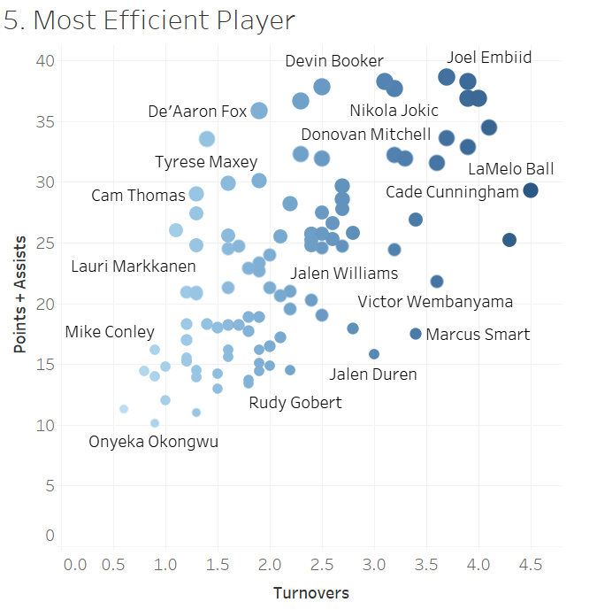
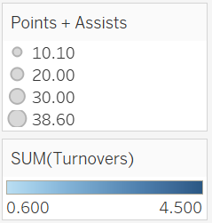
5. Who is the Most Efficient Player?
Notes:
In order to analyze efficiency, this visualization shows Points + Assists vs. Turnovers. Why? Because players targeting players might score more by default, but how many times are they losing the ball to the other team? We see younger players like LaMelo Ball scoring a lot of points for the Hornets, but also averaging a lot of turnovers per game, and this is probably due to inexperience. Then players like Joel Embiid, who score frequently, where it’s ok if they’re getting more turnovers. But the most efficient players are on the left top corner, as they’re scoring many points while averaging less than 2 turnovers per game.
To emphasize points + assists vs turnovers, points increasing in size are for points + assists and color darkening for number of turnovers.

Slide 22
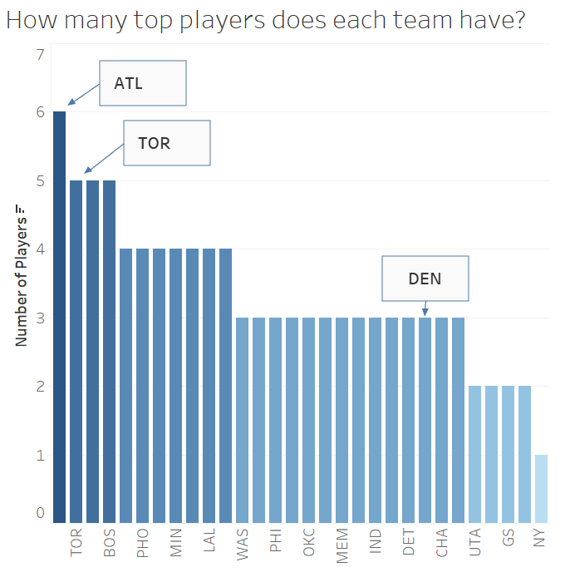
Theoretical Top Teams
Currently:
#1 Atlanta
#2 Toronto
#23 Denver originally power ranked #1
Notes:
Finally, this graph was just for fun, to explore whether or not teams with more top players are actually ranked higher currently. Theoretically, Atlanta and Toronto should be performing the best this season because they have 6 and 5 of the top 100 players, respectively. However, in reality the #1 spot in the power ranking is Denver with 3 of the top 100 players. We can attribute this to Atlanta having 6 players lower in ranking and Denver having 3 high-ranking players.

Slide 23
Conclusion
Trends found that clearly correlate with age
4th Visual: Older Player’s FT% trends up with age
Though, in the 3rd Visual depicting “Hustle Stats” (Defensive Stats)
Blocks + Steals distributed evenly through age groups
Notes:
To conclude, we found that there are some trends that correlate with age. Free Throw percentages were found to increase in accuracy with age, as older players have more experience attempting them on the court. Though, conversely, it was interesting to discover that defensive statistics were pretty evenly distributed throughout all ages of players.
As sports medicine improves, perhaps we will see an increase of older players in the NBA and at that point we will have a larger sample size of older players to analyze resulting in a more thorough analysis.

